Slide 1
CILogon-HA: Higher Assurance Federated Identities for DOE Science
September 2014 Update
Jim Basney jbasney@ncsa.illinois.edu
This material is based upon work supported by the Department of Energy under award number DE-SC0008597. Any opinions, findings, and conclusions or recommendations expressed in this material are those of the authors and do not necessarily reflect the views of the United States Government or any agency thereof.

Slide 2
CILogon – https://cilogon.org/
Provides personal digital certificates for access to cyberinfrastructure
Uses federated authentication for user identification

Slide 3
Federated Authentication
Log on to CILogon using your campus (InCommon) or Google (OpenID) account

Slide 4
Bridging InCommon and IGTF
Translating mechanism and policy across higher education and grid trust federations

Slide 5


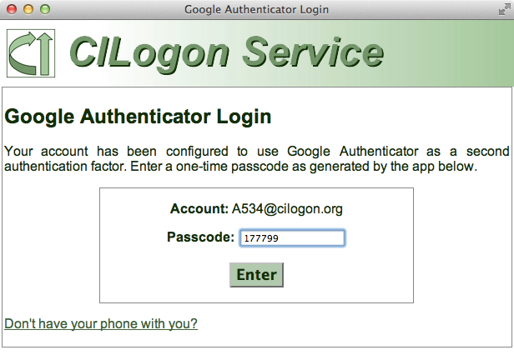
Multiple Levels of Assurance
CILogon Silver CA
InCommon Silver IDs
IGTF accredited February 2011
CILogon Basic CA
“Basic” InCommon IDs
IGTF accredited June 2014
Google Authenticator provides second authentication factor
Notes:
Developed new IGTF IOTA profile for CILogon Basic CA over past year. CILogon Basic was the first IOTA CA accredited.
Now able to provide IGTF certificates to users from all InCommon identity providers, using IGTF accredited CAs at both the Silver and Basic levels of assurance. Expanding access to IGTF certificates beyond the Silver level of assurance is particularly valuable given the slow adoption of the InCommon assurance program. Virginia Tech remains the only InCommon identity provider approved at the Silver level of assurance, with no new Silver identity providers approved in the past year.

Slide 6
Integrated with CyberInfrastructure

Slide 7
Integrated with Globus Nexus

Slide 8
Used by DOE KBase

Slide 9
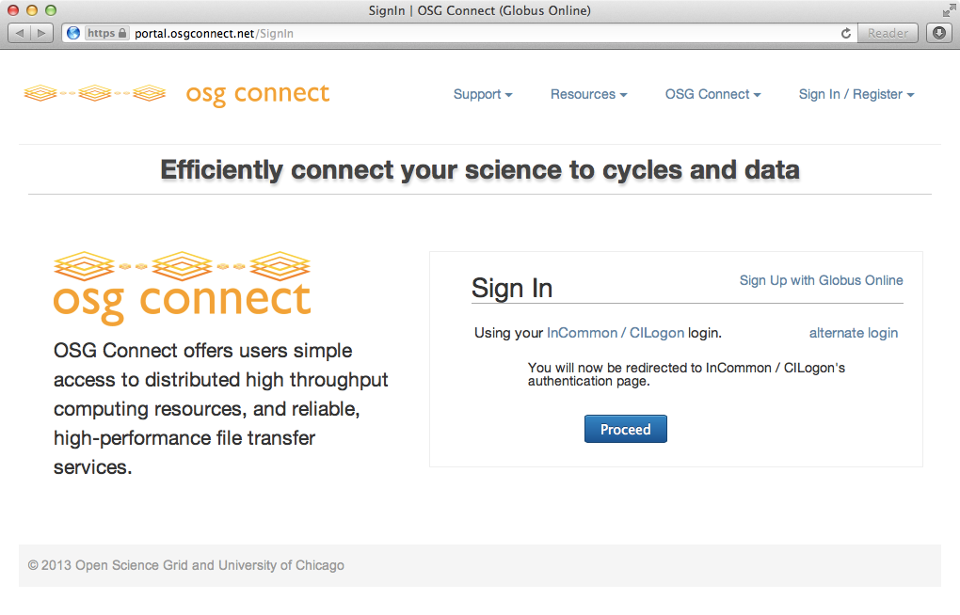
Used by OSG Connect
Notes:
In August 2013, Open Science Grid launched OSG Connect (https://osgconnect.net/), which “offers investigators simple and efficient access to distributed high throughput computing resources required by many of today’s most challenging problems in science, engineering, and the humanities.” OSG Connect supports easy sign up and sign in using federated campus identities through a combination of underlying technologies: Globus Nexus, CILogon, and InCommon. Globus Nexus, part of Globus Online, provides identity and group management for OSG Connect. Globus Nexus in turn relies on CILogon to enable access via campus identities through the InCommon federation. The result is that researchers can easily access OSG Connect using their existing campus logins.

Slide 10
Used by ATLAS Connect
Notes:
In February 2014, the US ATLAS project launched ATLAS Connect (http://connect.usatlas.org/), which provides a version of OSG Connect tailored to the US ATLAS physics community. Like OSG Connect, ATLAS Connect supports sign in via CILogon for federated InCommon access. In support of ATLAS Connect, CILogon-HA staff worked with InCommon staff to increase the number of InCommon identity providers available to ATLAS Connect users. In January 2014, out of 44 US ATLAS collaborating institutions, 40 operated InCommon identity providers of which 23 interoperated with CILogon. As of May 2014, an additional 7 of those identity providers are interoperating with CILogon in support of ATLAS Connect. 3 more since then. 23+10=33 total out of 44.

Slide 11
CILogon and XSEDE
CILogon
CILogon is
a component in the XSEDE architecture
following the XSEDE engineering process: architecture, design, and security reviews and operational acceptance tests
XSEDE provides sustained operational support to CILogon users (ATLAS, DataONE, OOI, OSG, KBASE, LIGO, etc.)
Including backup CILogon instance at NICS

Slide 12
Notes:
Adding more IdPs to CILogon continues to be a major focus. InCommon Research & Scholarship program helps.
This year special focus on IdPs desired by ATLAS as previously discussed.

Slide 13
Notes:
steady growth in user base. now over 3,000 users
Apr 2013 – LIGO use started
August 2013 – OSG Connect

Slide 14
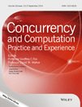
Our Journal Article
Jim Basney, Terry Fleury, and Jeff Gaynor, "CILogon: A Federated X.509 Certification Authority for CyberInfrastructure Logon," Concurrency and Computation: Practice and Experience, Volume 26, Issue 13, pages 2225-2239, September 2014. http://dx.doi.org/10.1002/cpe.3265

Slide 15
“What question does your research motivate you to now ask?”
What models are effective for exchange of user information in distributed systems?
need user info for authentication, authorization, accounting, incident response, troubleshooting
models: virtual organization, gateways/hubs, user consent/control, certification (InCommon R&S, IGTF), self-asserted compliance (InCommon Bronze, REFEDS CoC)
challenges: regulatory, scaling, information quality/timeliness, misaligned goals
Who owns/controls the data?
Notes:
only 25% of InCommon IdPs have signed on to R&S; REFEDS R&S being discussed.
continued debate about US-EU data exchange; changes to EU privacy legislation coming
right to be forgotten in EU shows personal ownership over data; opposite of US perspective
REFEDS Code of Conduct

Slide 16
Thanks!
jbasney@ncsa.illinois.edu
www.cilogon.org

